Slide 1

Bideokluba
Datu-Baseak
Xabier Lekunberri
Iker Ortiz
Gontzal Pujana
Eneko Sampedro
Javier Sautua

Slide 2
Erabilitako plataformak

Slide 3








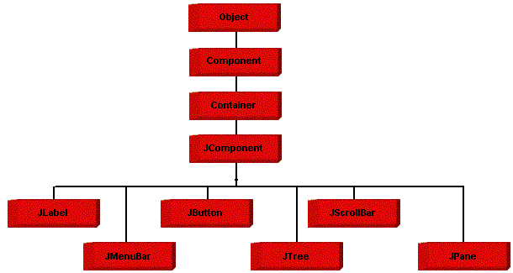


Erabilitako plataformak

Slide 4
Diagrama

Slide 5
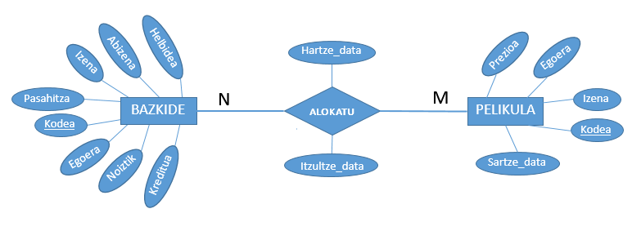
Diagrama

Slide 6
Taulak

Slide 7
CREATE TABLE BAZKIDE(
Kodea VARCHAR(15) NOT NULL,
Pasahitza VARCHAR(15) NOT NULL,
Izena VARCHAR(64) DEFAULT '',
Abizena VARCHAR(64) DEFAULT '',
Helbidea VARCHAR(15) DEFAULT '',
Kreditua SMALLINT unsigned DEFAULT 0,
Egoera VARCHAR(15) DEFAULT 'alta',
Noiztik DATETIME,
PRIMARY KEY(Kodea)
) ENGINE=InnoDB DEFAULT CHARSET=utf8;
BAZKIDE

Slide 8
CREATE TABLE PELIKULA(
Kodea VARCHAR(15) NOT NULL,
Izena VARCHAR(64) DEFAULT '',
Prezioa INT unsigned DEFAULT 0,
Egoera VARCHAR(15) DEFAULT 'libre',
Sartze_data DATETIME,
PRIMARY KEY(Kodea)
) ENGINE=InnoDB DEFAULT CHARSET=utf8;
PELIKULA

Slide 9
CREATE TABLE ALOKAIRUAK(
Bazkide_kodea VARCHAR(15) NOT NULL,
Pelikula_kodea VARCHAR(15) NOT NULL,
Hartze_data DATETIME NOT NULL,
Itzultze_data DATETIME,
PRIMARY KEY(Bazkide_kodea, Pelikula_kodea, Hartze_data),
FOREIGN KEY(Bazkide_kodea) REFERENCES BAZKIDE(Kodea) ON UPDATE CASCADE ON DELETE CASCADE,
FOREIGN KEY(Pelikula_kodea) REFERENCES PELIKULA(Kodea) ON UPDATE CASCADE ON DELETE CASCADE
) ENGINE=InnoDB DEFAULT CHARSET=utf8;
ALOKAIRUAK

Slide 10
Galderarik?
Kodea
https://github.com/Xabiier/Bideokluba

